Slide 1
Data Analytics for eSports
Srijeet Mohan Nair
229001998
smn24@student.le.ac.uk
ABSTRACT
The well-known multiplayer online game League of Legends is the subject of the game-statistic analysis for my study. In order to gain insight and assign them a ranking based on various crucial variables, the champions effectiveness, success and performance are examined. In order to make a comparison that will ultimately lead to each contributing to some type of values, the same analytical technique is used to a number of patches that have been issued as well as time series data (year).

Slide 2
TOPIC AND CONTEXT
A multi-player online battle arena(MOBA) game called League of Legends (LoL).
By taking into account the game updates that have been implemented over years, accurately rank the champions based on their performance ability and effectiveness.
The goal would be to encourage players, whether new or experienced, to win more games.
The following data points were analysed:
damagetakenperminute, total cs, champion
damagetakenperminute, total cs, champion
total cs, champion, patch
damagetochampions, champion, patch
kills, deaths, champion, position
minionkills, monsterkills, total cs, patch, champion
damagetochampions, totalgold, champion, patch
Data source for collecting these datapoints: University of Leicester Blackboard(Google Drive).

Slide 3
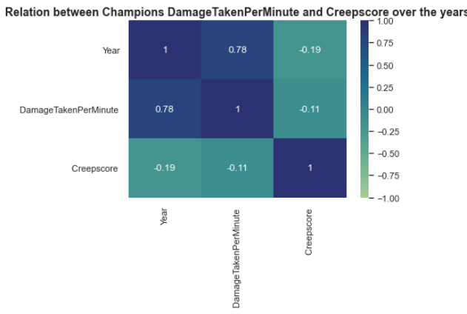
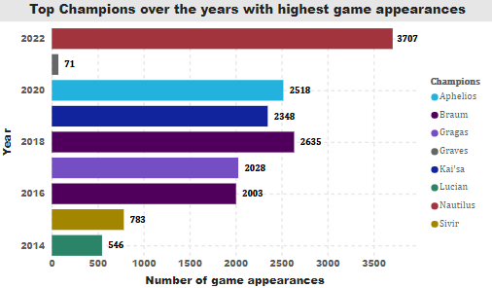
ANALYSIS 1 - How Champions DamageTakenPerMinute and Creepscore are related over the years, and which champions appear most often ?
Correlation matrix inference.
Negative correlation observed (-0.11).
DamagTakenPerMinute and Creepscore are independent.
Analysed the champions with highest appearance for each year.
Factors considered: DamagTakenPerMinute and Creepscore.

Slide 4
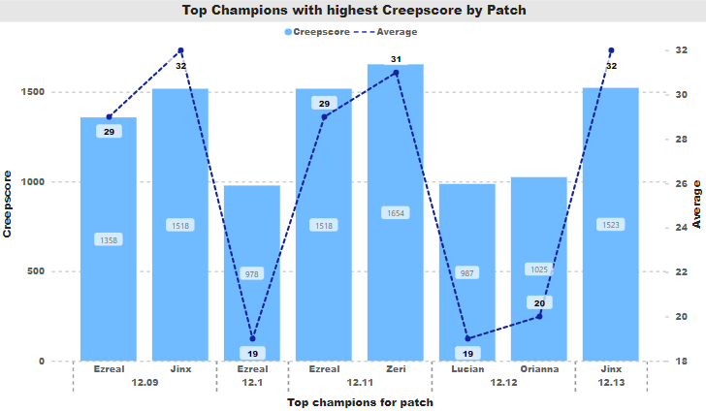
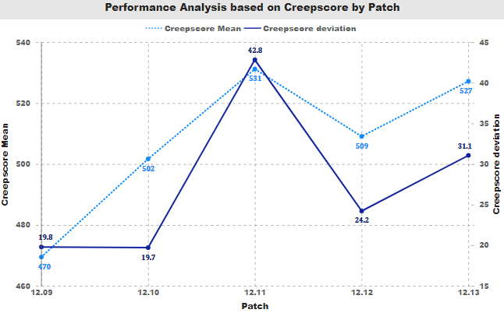
ANALYSIS 2: Which Champions appear most in the top 10% highest Creepscore, and how has this changed over the last five patches?
Champions with highest probability to come on top in terms of creepscore.
Ezreal – most consistent champion followed by Jinx.
For the last 5 patch updates, the champions creepscore performance trends are majorly observed.
Mean and Deviation increases → champions performance affected in a good way.
Mean and Deviation decreases → champions performance affected in a bad way.

Slide 5
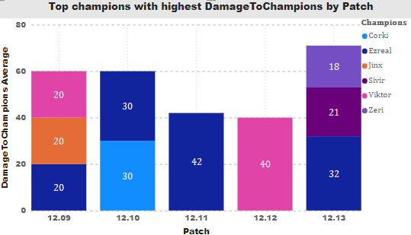
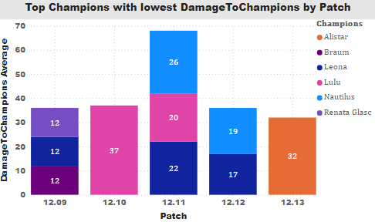
ANALYSIS 3: Which Champions appear most in the highest and lowest 10% Damage to Champions, and how has this changed over the last five patches?
Ezreal – the most consistent champion in terms of highest DamageToChampions, followed by Viktor.
Leona – the most consistent champion in terms of lowest DamageToChampions, followed by Lulu and Nautilus.

Slide 6
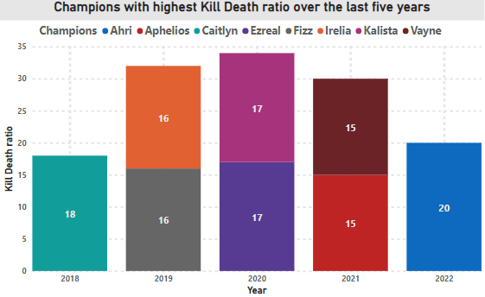
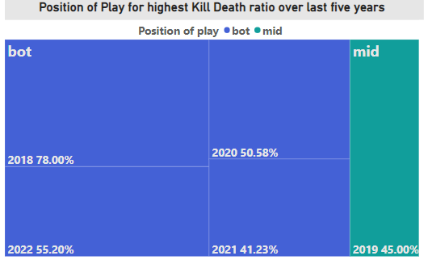
ANALYSIS 4: Analysing the Champions with the highest Kill/Death ratio over the years and the impact of Position of Play on this ratio.
Analysed the champions with highest kill death ratio for each year.
Major Factors considered: Kills, Deaths
3 years out of 5 recorded co-champions.
Impact of position of play for highest kill death ratio.
Treemap visualization inference.
Trend over last 5 years shows playing at bottom position (the marksman) is the most effective.

Slide 7
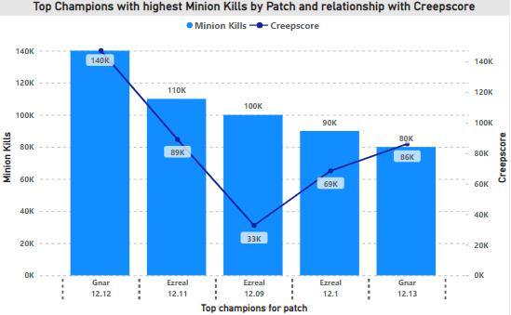
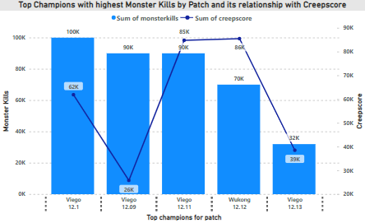


ANALYSIS 5: Keeping in mind the creepscore analysis, is creepscore related with minion kills and monster kills? Which Champions appear most in the top 10% highest minion kills and monster kills?
Champions with highest probability to come on top in terms of minion kills.
Ezreal – most consistent champion followed by Gnar.
Comparing minion kills with creepscore, no dependency or association observed ( p-value > 0.05 )
Champions with highest probability to come on top in terms of monster kills.
Viego – most effective champion throughout.
Comparing monster kills with creepscore, no dependency or association observed ( p-value > 0.05 )

Slide 8
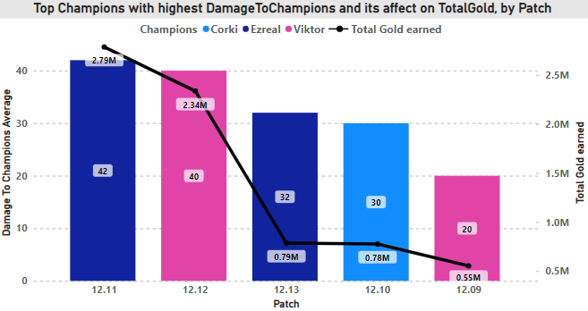
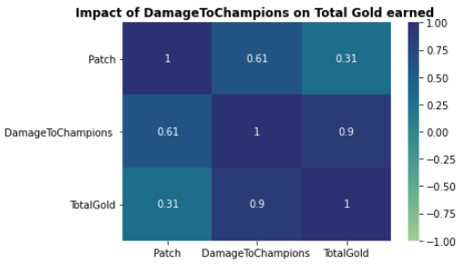

ANALYSIS 6: For the last five patch updates, identify the Champions that appears the most in highest 10% Damage To Champions and how does it affect the Total Gold earned?
Ezreal and Viktor effective in terms of DamageToChampions.
Total Gold earned directly proportional with DamageToChampions score.
Correlation matrix inference.
Positive correlation observed (0.9).
Pearson’s Correlation statistics outputs p-value < 0.05.
DamageToChampions and TotalGold earned are dependent.

Slide 9
CONCLUSION
Champions Damage taken per minute and Creepscore are not associated.
For each year, the most used champions in the game battle was analysed.
Based on kill death ratio, top champions are analysed along with the impactful position of play over the last five years.
Based on Creepscore, Damage to champions, Minion kills and Monster kills, top champions are analysed for the last five released patches, respectively.
Top champions creepscore mean and deviation analysis show increase-decrease trend for the last five released patches.
Minion kills and Monster kills when considered and compared separately with creepscore are not associated.
Total gold earned and Damage to champions are associated.
VALUE STATEMENT
Cultural value by improving player’s knowledge on selecting a champion more effectively inorder to win more games.

Slide 10
DEVELOPMENT NEEDS ANALYSIS
Python programming language.
pandas python package (corr() method for correlation)
seaborn and matplotlib data visualization libraries.
R programming language.
tidyverse library.
statistical inferencing functions(t-test and cor.test for correlation)
Power BI. (new learn)
data transformation.
building meaningful visualizations for relevant attributes.
depicting relationship between the attributes.
On a scale of 1 – 10, my confidence after League of Legends game-statistic analysis using Python programming language is 7, R programming language is 7 and Power BI is 7.

